Slide 1
iOS vs the rest
Where do they live and what do they do?
Sjors Nijhuis 4157478
Kevin van der Mark 4154509

Slide 2
Extracting information on chip set and vendor type in WiFi systems
Obtain MAC addresses via TShark
Save timing and amount of packets
Process data

Slide 3
Goal
Locate boarding and exit location of users
Search for patterns regarding types of devices, usage and locations.

Slide 4
Questions asked:
Which type of users use the train WiFi the most and how intensive?
Are cities linkable to types of devices used? E.g. iPhone users generally come from X and go to Y.

Slide 5
Method
Link MAC address to vendor
Split in iOS and other devices
Locate user boarding and exiting the train
Determine amount of WiFi usage

Slide 6
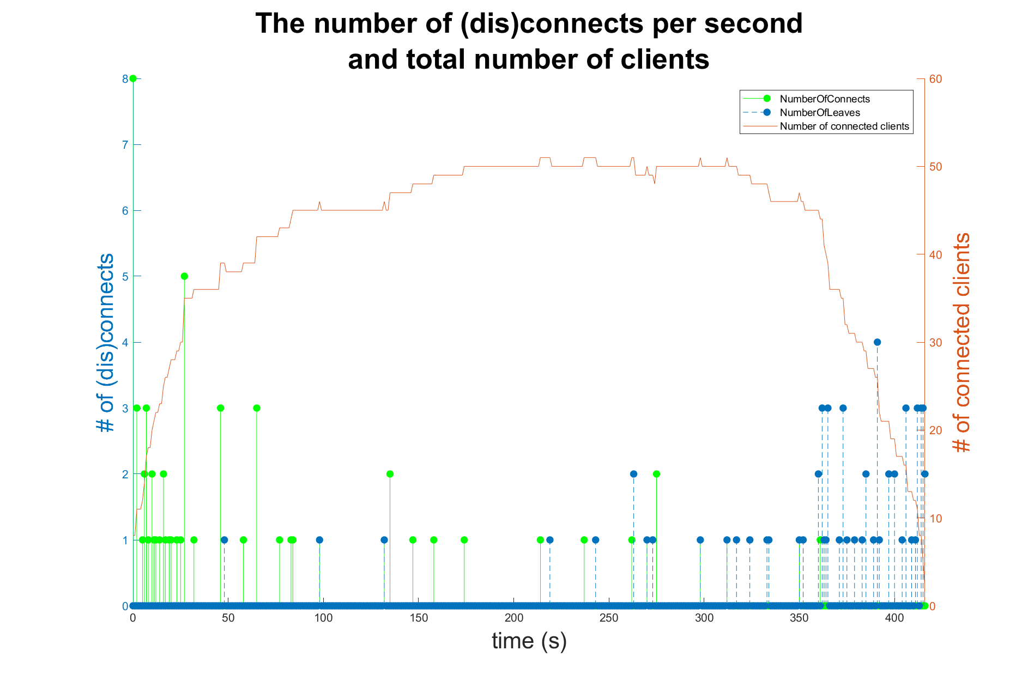
Notes:
Where do users board and exit the train

Slide 7
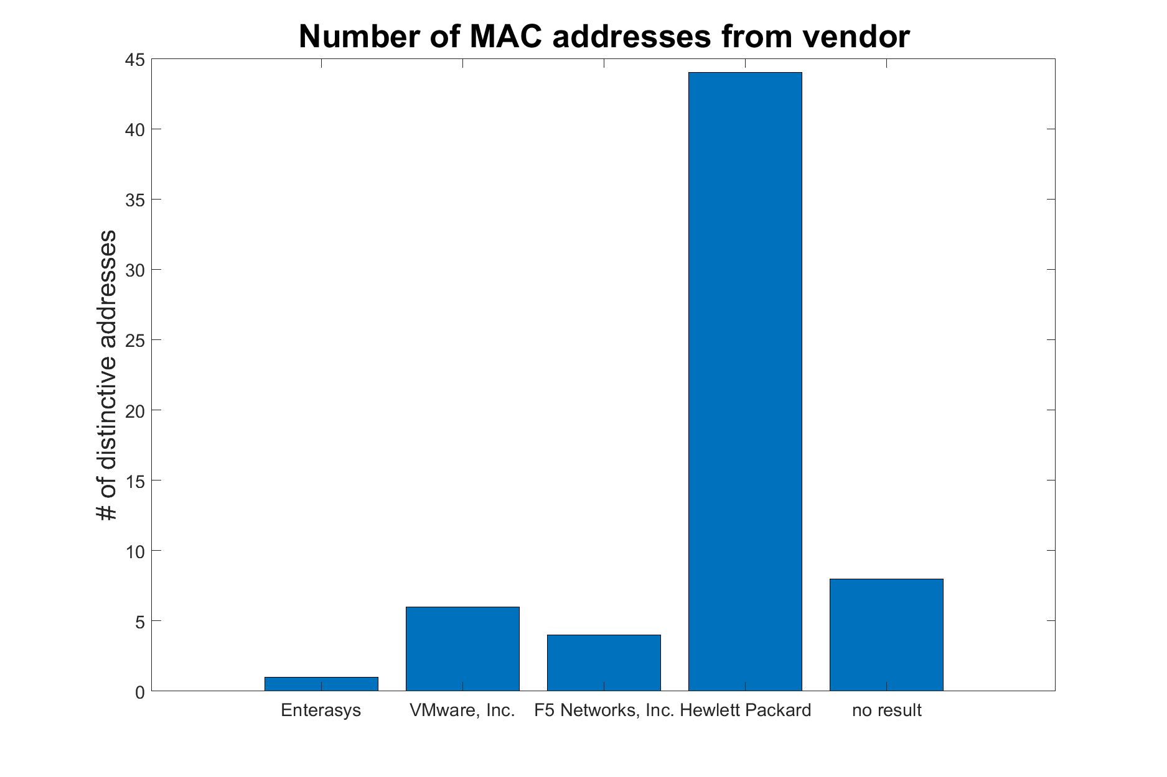
Notes:
Which devices are used

Slide 8
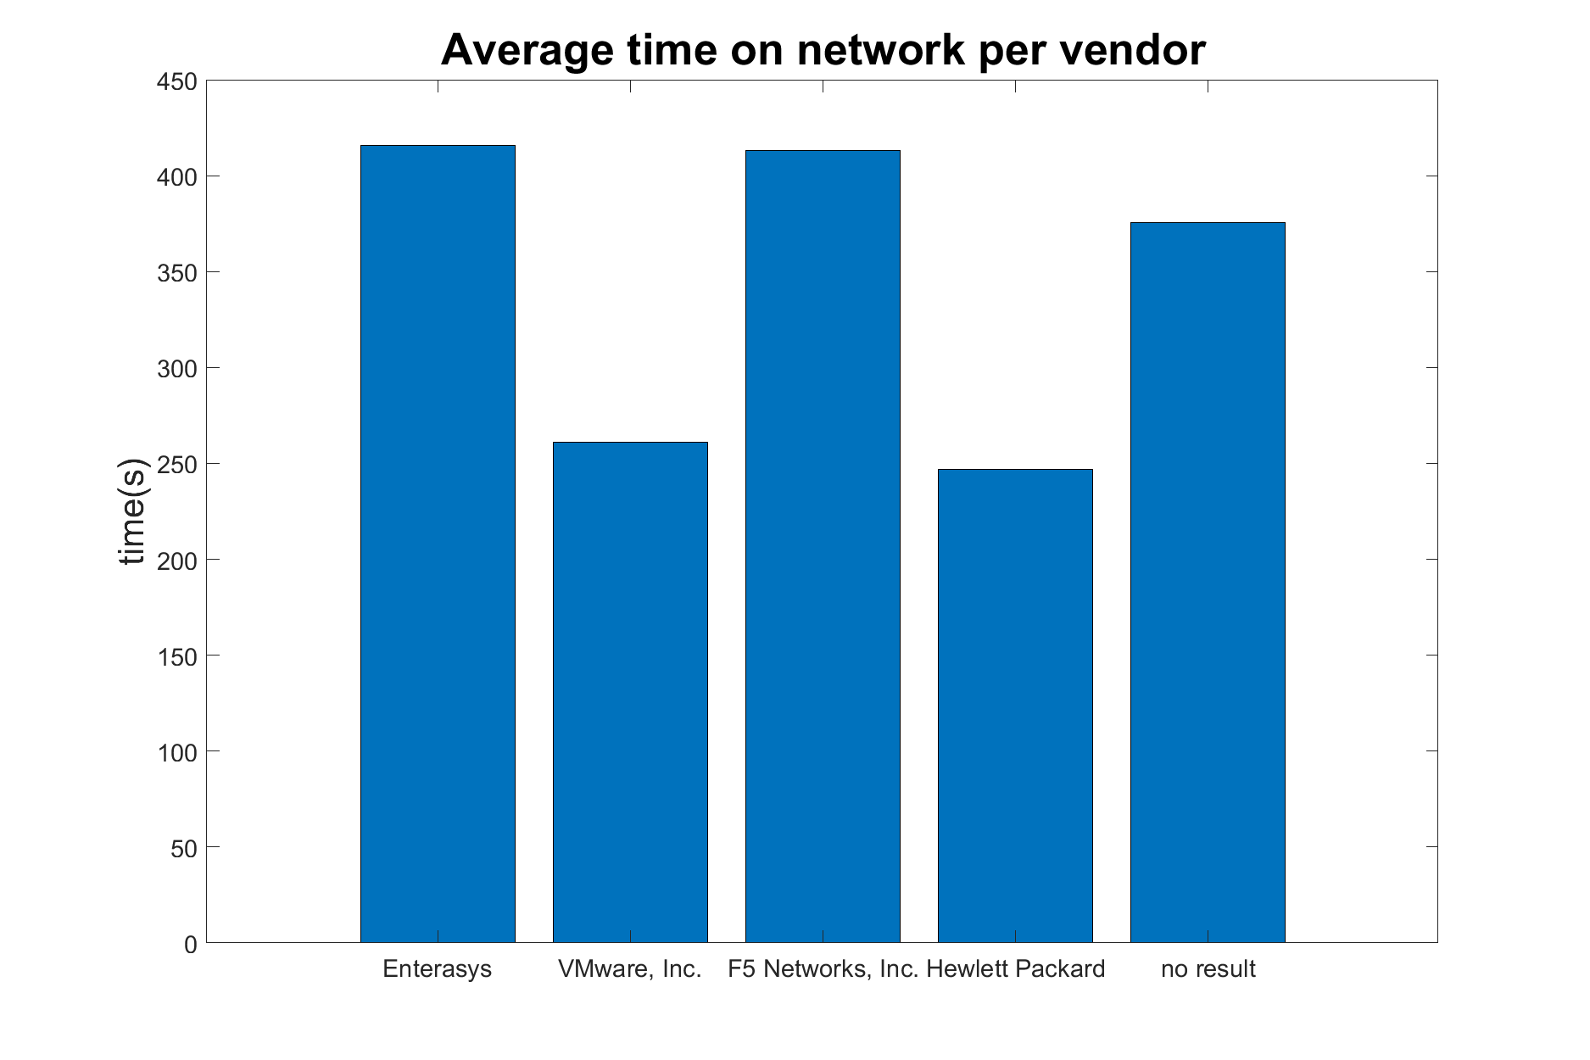
Notes:
How long are users in the train

Slide 9
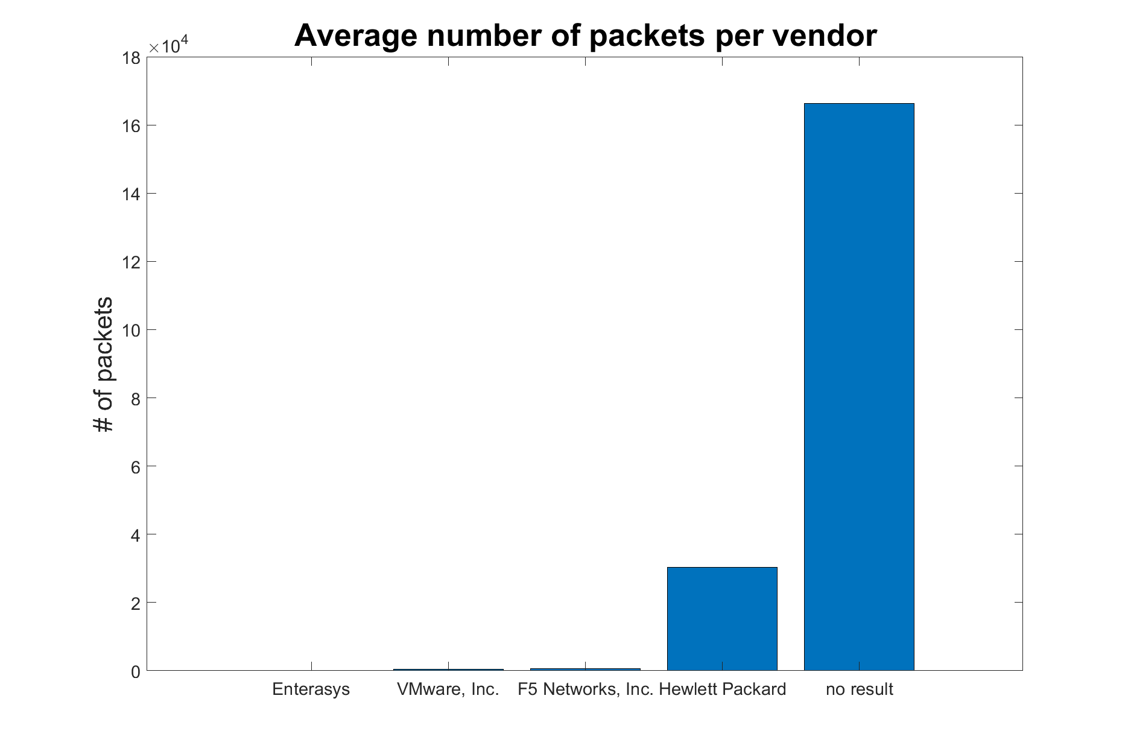
Notes:
Are users connected for Whatsapp, browsing or HD video streaming?

Slide 10
Conclusion
Currently the data is not yet based on live results, which means the main question: “iOS vs the rest - Where do they live and what do they do?” can not be answered yet.
Live measurements will be performed soon.
Stay tuned and find out.

